Slide 1
College of Agriculture, Health and Natural Resources
TITLE
NAME
DATE/CONTACT INFO

Slide 2
College of Agriculture, Health and Natural Resources
TITLE NAME
DATE/CONTACT INFO

Slide 3
College of Agriculture, Health and Natural Resources
TITLE NAME
DATE/CONTACT INFO

Slide 4
College of Agriculture, Health and Natural Resources
TITLE NAME
DATE/CONTACT INFO

Slide 5
College of Agriculture, Health and Natural Resources
TITLE NAME
DATE/CONTACT INFO

Slide 6
College of Agriculture, Health and Natural Resources
TITLE
NAME
DATE/CONTACT INFO

Slide 7
College of Agriculture, Health and Natural Resources
TITLE
NAME
DATE/CONTACT INFO

Slide 8
College of Agriculture, Health and Natural Resources
TITLE
NAME
DATE/CONTACT INFO

Slide 9
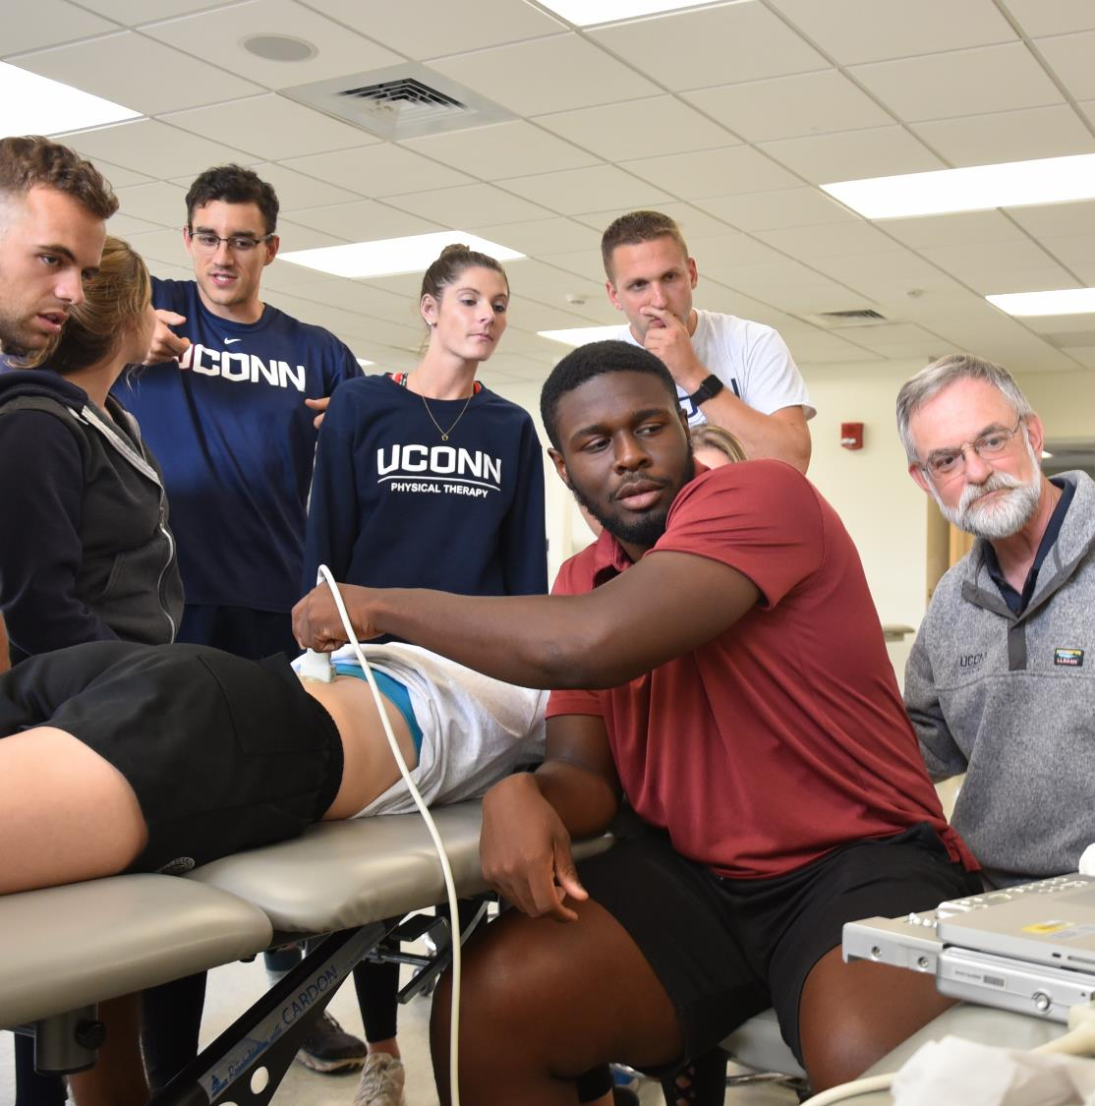
College of Agriculture, Health and Natural Resources
TITLE
NAME
DATE/CONTACT INFO

Slide 10
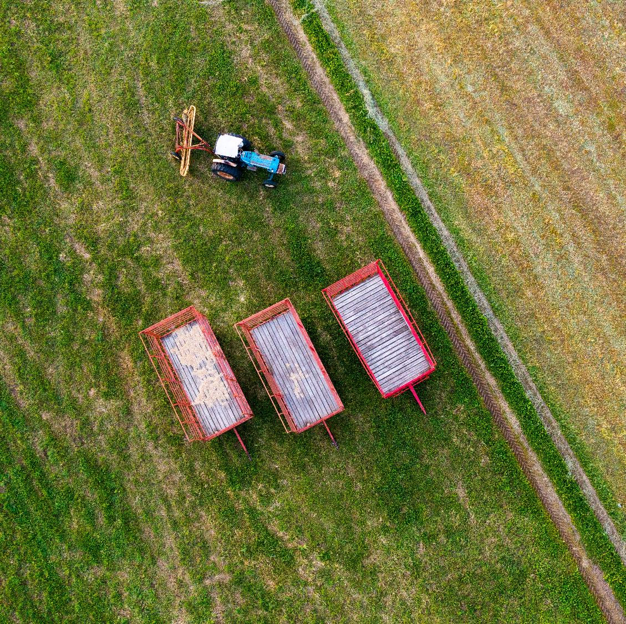
College of Agriculture, Health and Natural Resources
TITLE
NAME
DATE/CONTACT INFO

Slide 11
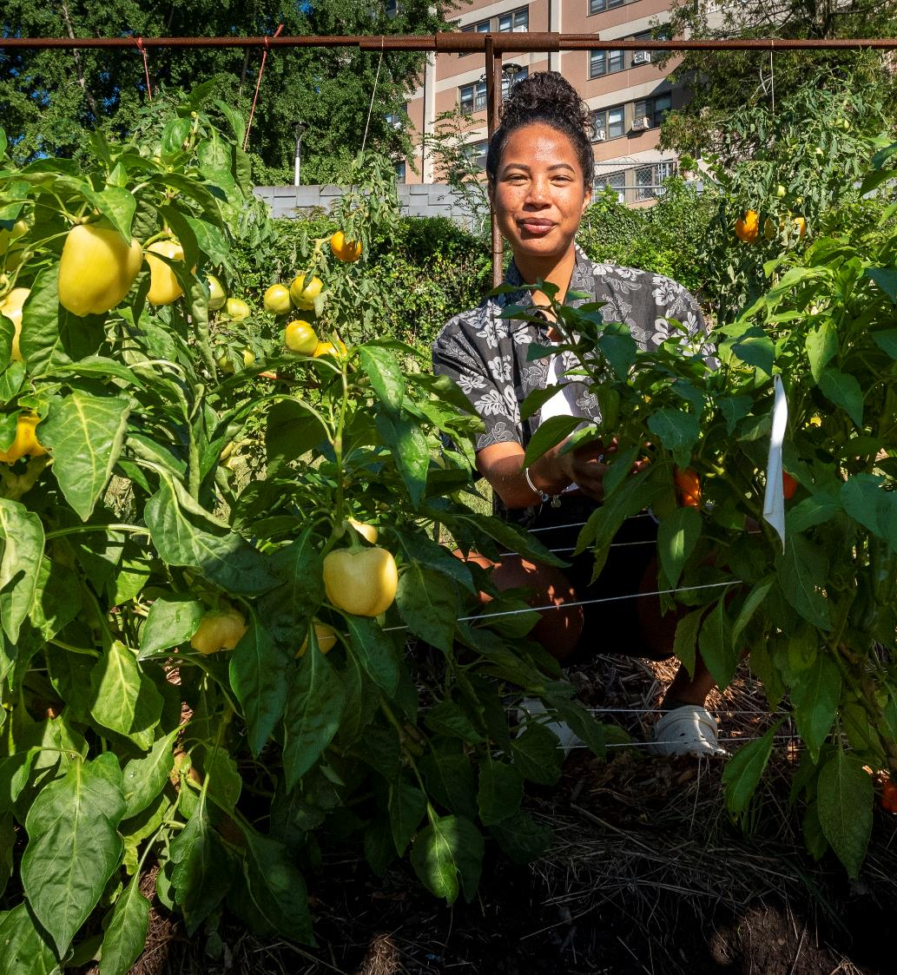
College of Agriculture, Health and Natural Resources
TITLE
NAME
DATE/CONTACT INFO

